Slide 1
Inventory System using Spring Boot
CREATED BY
Pratap Sakat :- EONFWL618567
Sahithi Tantravedi :- EBEON0622615707
Mayuri Kalbhor :- EBEON0622617904
Guided by
Varadharajan Sir.

Slide 2
INDEX
SR NO | TITLE
1) | INTRODUCTION
2) | MODULE LIST
3) | MODULE(S) GOAL
4) | ER DIAGRAM
5) | TECHNOLOGY USED
6) | SYSTEM CONFIGURATION
7) | CONTROL FLOW DIAGRAM
8) | FUTURE ENHANCEMENT
9) | CONCLUSION

Slide 3
INTRODUCTION
The Ice cream shop pos system is developed using Spring boot. The project is built to manage sales and transactions. To make a new transaction, fields such as: Ice cream type and Drink type, quantity needs to be selected.

Slide 4
ICE CREAM SHOP POS Module List
Items
Products
Automatic Billing System

Slide 5
MODULE(S) GOAL
Keep the stock in such a way that it is neither overstock nor understock.
To understand stock levels and stock’s location in warehouses.

Slide 6
ER Diagram
Delete
Flavor
Quantity
Total
Items
Billing
Price
Add Product
Total
Reset

Slide 7
TECHNOLOGY USED
Backend : Spring Boot, Spring MVC, Java , Servlet
Frontend : JSP , HTML , CSS , Java Script
Styling : Bootstrap
Project Management : Maven
Database : MYSQL
Server : Embedded Tomcat Server

Slide 8
SYSTEM CONFIGURATION
The user should have the appropriate version of windows.
The system should have up to 1 GB ram minimum requirement for the application.
The application should be installed on the system.
Internet Connectivity is a must for this purpose.
CPU with a speed of 1.3Ghz is a good choice for normal usage.

Slide 9
CONTROL FLOW DIAGRAM
Product
Management
Ice Cream Inventory System using Spring Boot
Billing
Quantity
Sales Management

Slide 10
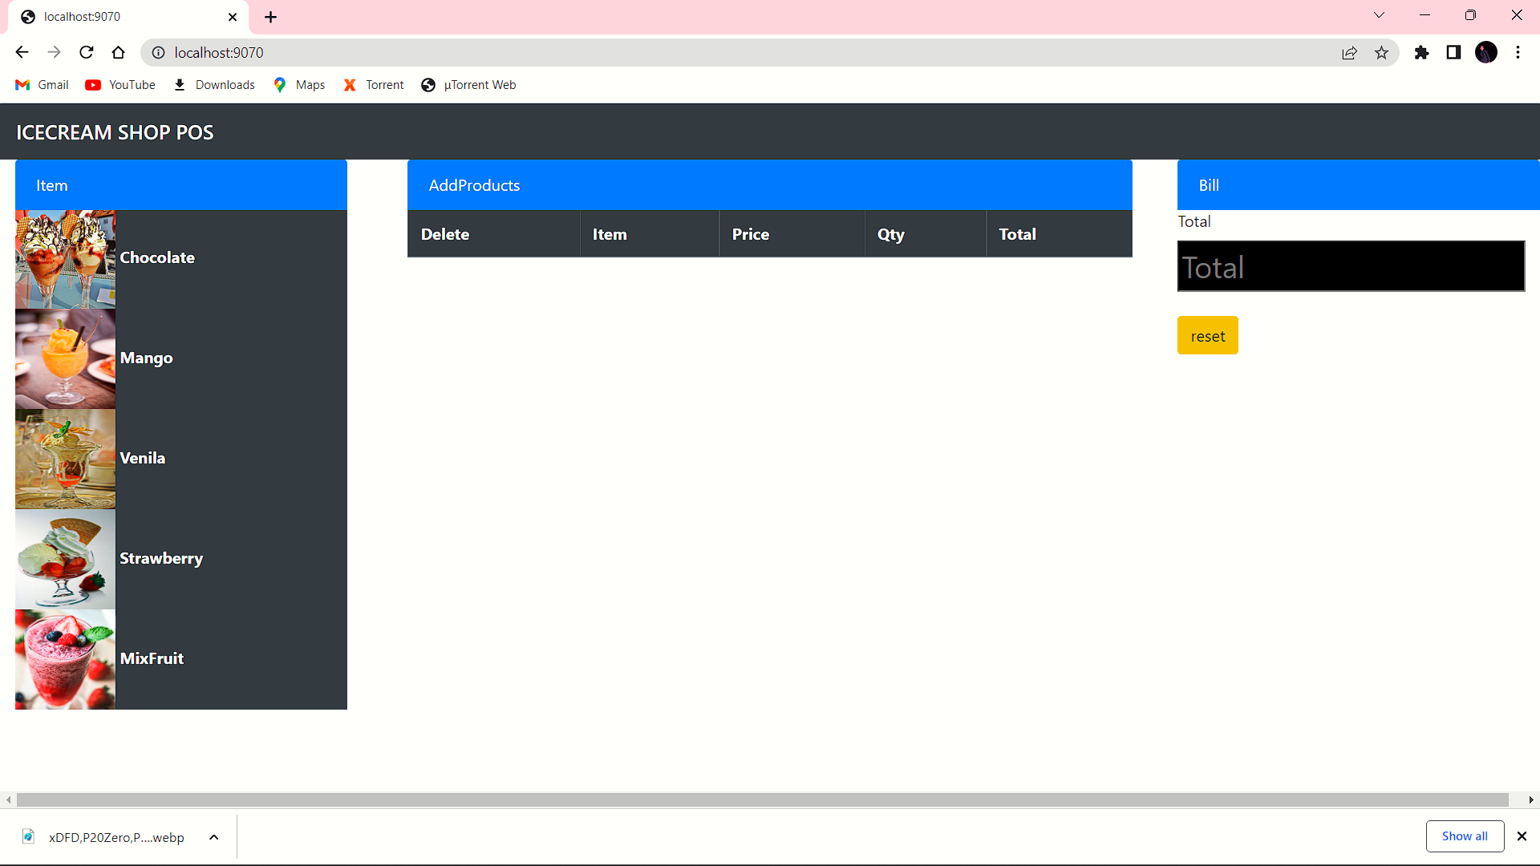

Slide 11
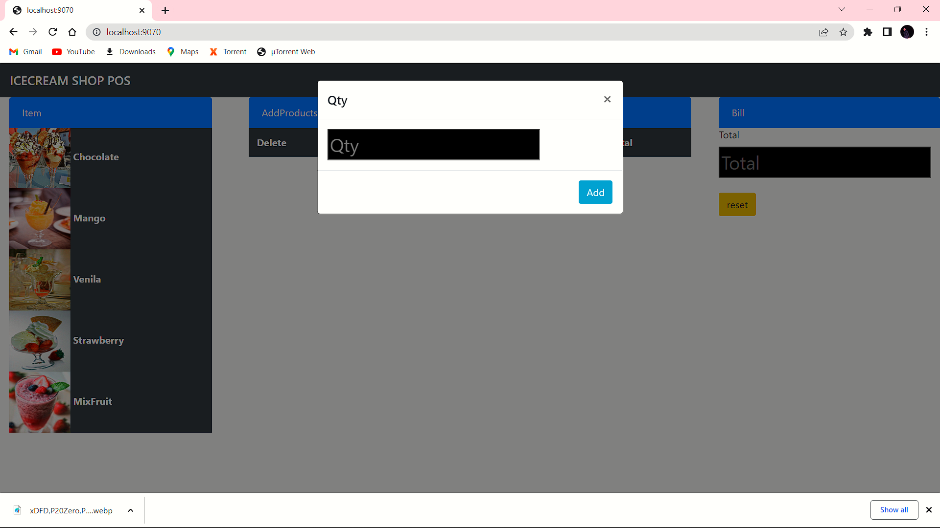

Slide 12


Slide 13
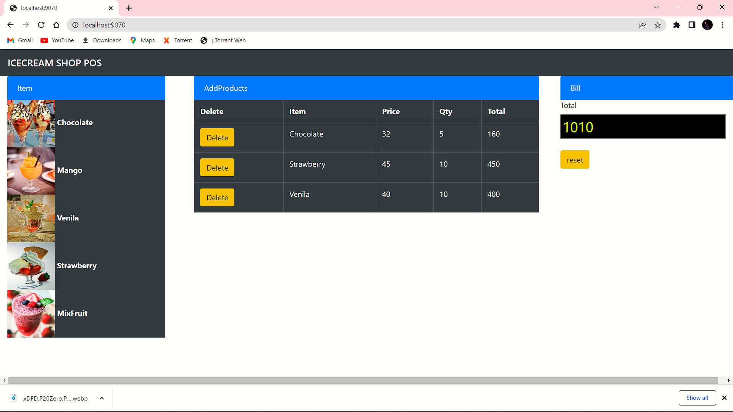

Slide 14
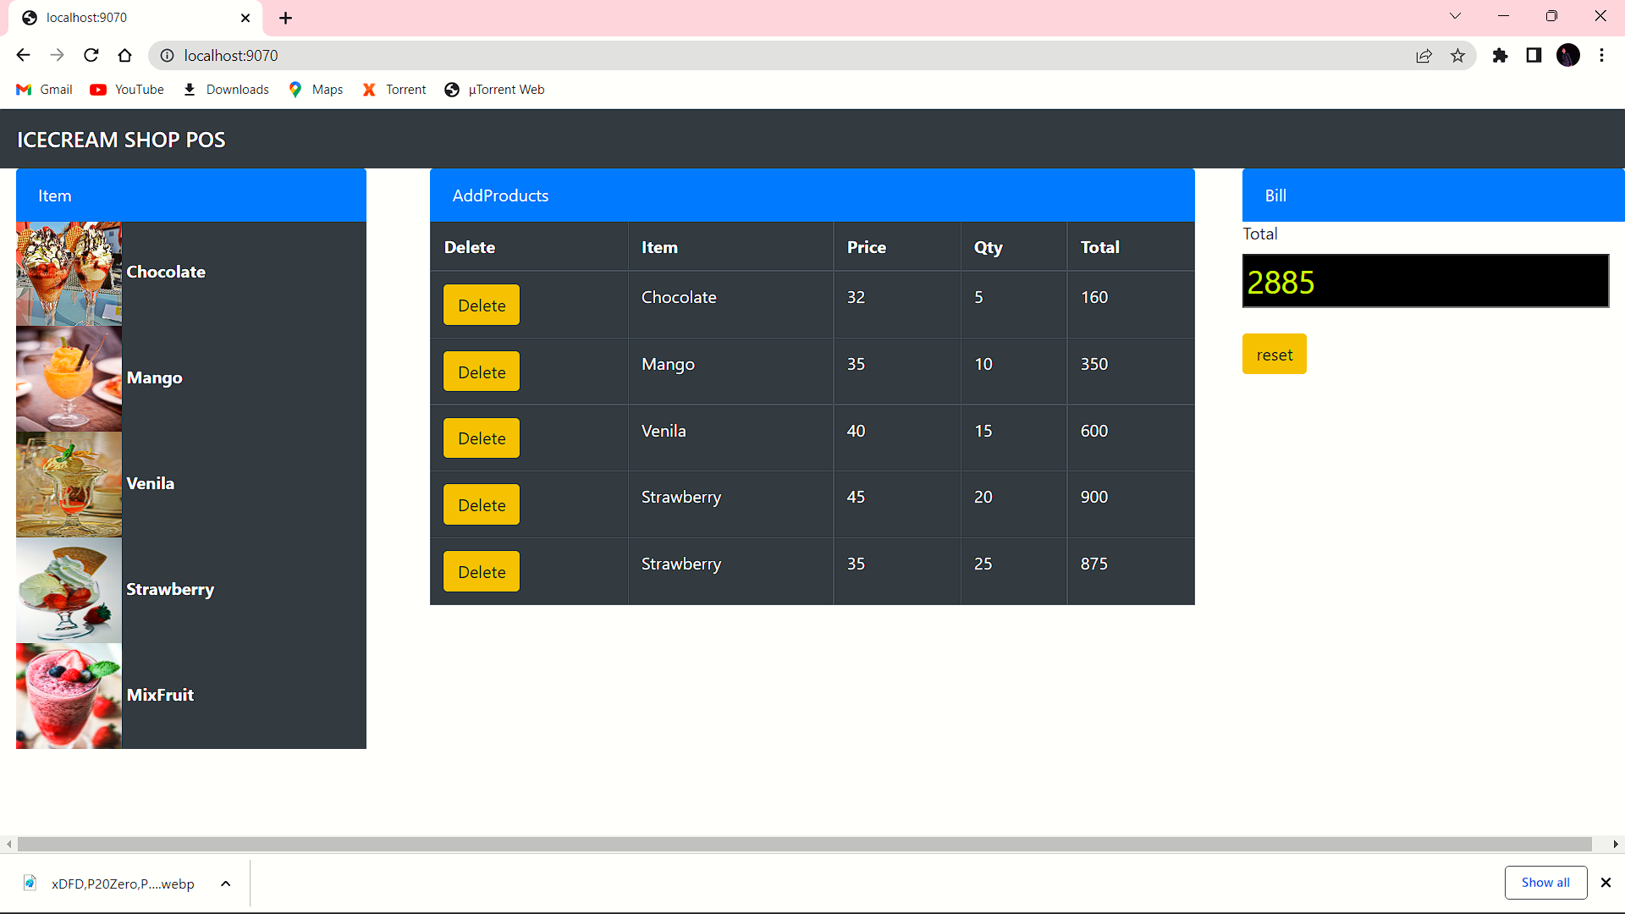

Slide 15
FUTURE ENHANCEMENT
Ice cream is temperamental. One negligent moment of leaving a fridge open can spoil a lot of stock, leading to a double down of losses, goods and reputational damage. Yet with display fridges spread across the globe in fuel stations, supermarkets and cafes, it is impossible to control the ecosystem sufficiently. Compounding this are the traditional fridges, which, though apt at cooling, are not sophisticated enough to lend a hand. Worse still, replacing them all with modern equivalents presents a huge and often debilitating cost.

Slide 16
CONCLUSION
This software reduces the amount of manual data entry and gives greater efficiency. The User Interface of it is very friendly and can be easily used by anyone.

Slide 17
THANK YOU

